Slide 1
Remotely sensed LAI and planting estimate plan; cleaning Matopiba data
June 20, 2018

Slide 2
Matopiba Survey

Slide 3
Matopiba dataset cleaning: “pesquisaMATOPIBA_cleaned_toGEE.xlsx”
For verbal dates: put a guess with errors
“beginning”, “middle”, end of month: 5th , 15th, and 25th of month with errors +/- 15 days
“first half” or “first fornight”: 7th of month with errors +/- 15 days
“second half” or “second fortnight : 21st of month with errors +/- 15 days
A month: 15th of month with errors +/- 20 days
Between two dates: take the middle of the dates, with appropriate error
“Max ___” : ___ +/- 10 days
For cells with no date information, put Dec 31, 1899 as the flag in the Excel file; after reading into GEE, can then filter out the ones with this date
pesquisaMatopiba_cleaned_toGEE.xlsx file doesn’t have all the survey questions; only the ones with planting/harvest date and yield. The pesquisaMatopiba_cleaned_full.xlsx file has all the data.

Slide 4
GEE file: Matopiba Survey
Import Matopiba planting/harvest date data, and overlay that with LAI timeseries (it comes from MODIS for now)
Visualize a specific point’s LAI points and planting/harvest date information
Export planting/harvest date data along with LAI points
This looks only at a single point/year at a time
GEE file: Matopiba Survey v2
For the verbal dates with associated errors, turn those into a wider plant start/end and wider harvest start/end for export
GEE file: Matopiba Survey v3
Extend reading in planting/harvest survey data to multiple points instead of one point, as before
Filter out “no data” flag for plant/harvest dates, which is Jan 1 1900 in the Excel file but is Jan 1 2000 when read into GEE; if there is only one of the endpoints available, take out the whole point. E.g. if there is plant start but not plant end, take out the whole point. But if the same point/year has harvest info, don’t take out the whole point.

Slide 5
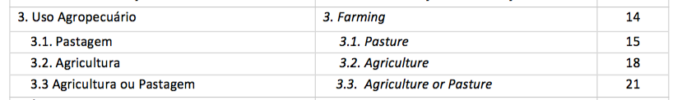
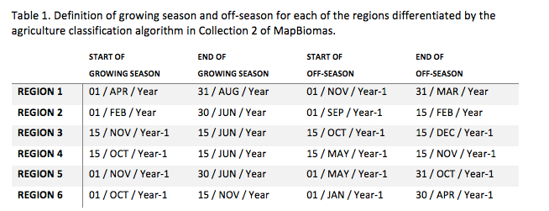
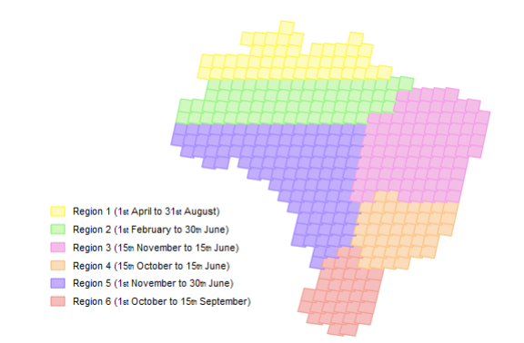
File: Matopiba Survey v3
Add on CAR polygons and Mapbiomas collection 2.3 to make sure the points are actually on a field
Mapbiomas Collection 2.3 farming pixels:
NOTE: mapbiomas only goes until 2016… it corresponds to the 2015/2016 season
For each mapping year, images of the growing season and the off-season were selected based on the periods presented in Table 1.

Slide 6
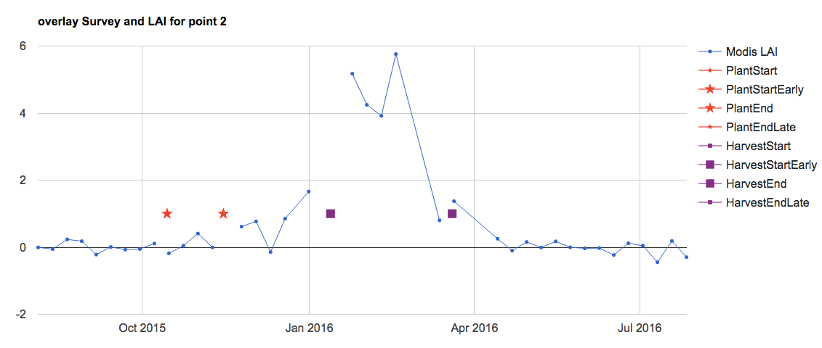
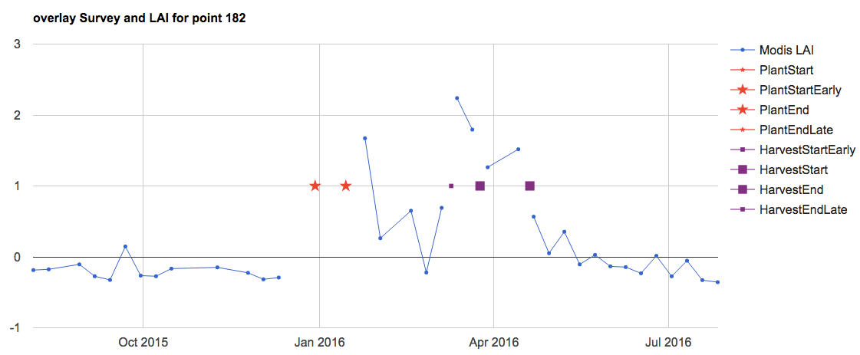
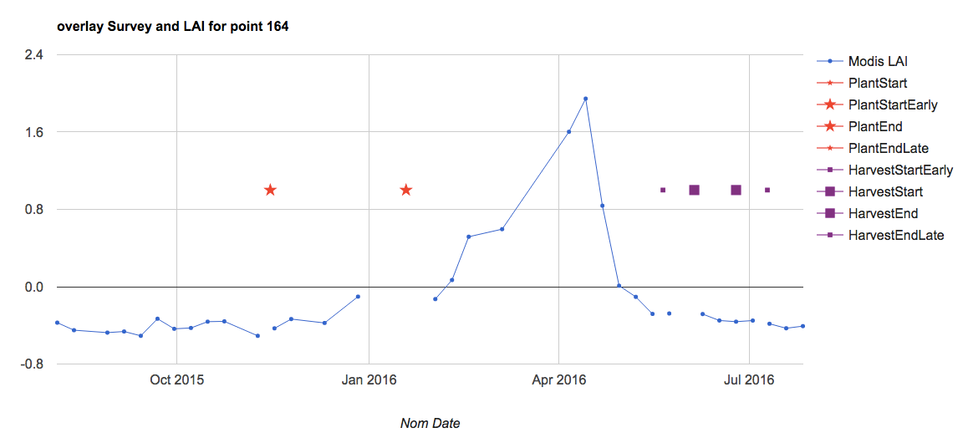
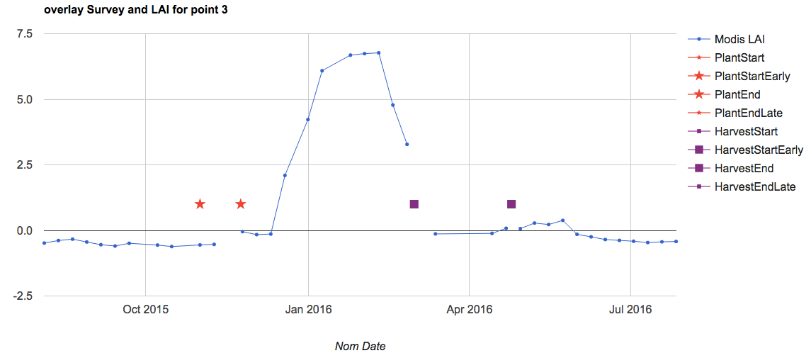
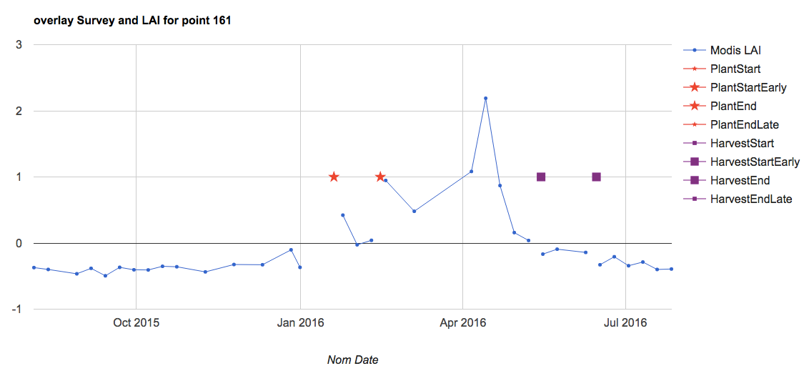
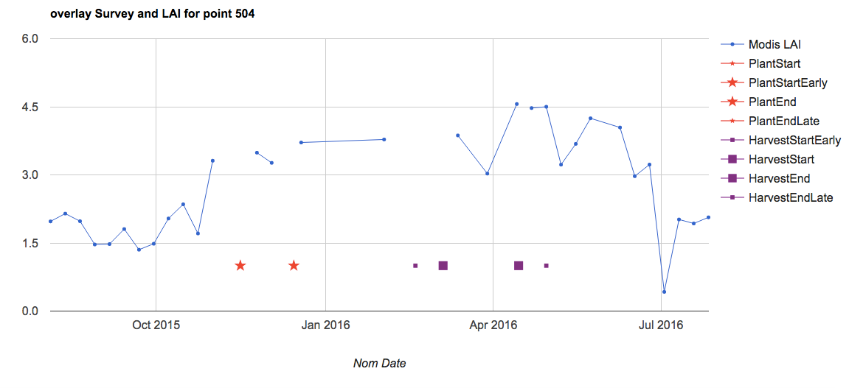
Does considering CARpolys help us get rid of “non farm” pixels?
The following were the pixels outside of CARpolys. They don’t look very bad compared to the ones in CARpolys. (Note, this is all for Modis Aqua only)

Slide 7
GitHub Info

Slide 8
GitHub tutorial: (doesn’t mention branching here)
https://www.youtube.com/watch?v=E8TXME3bzNs
My GitHub account name: minghui-zhang. The private GitHub account is called cohnlab.
GitHub basics:
Create a new repository on GitHub and initialize w/ Readme.
If working on a computer that doesn’t have the repository yet, do git clone (url of repository). Otherwise, just do a git pull to see latest changes in repository. (make sure that you are navigated to the repository in the local computer though)
To make changes to the repository, navigate to the repository folder first.
Do git status to see new changes;
Do git add –A or git add (filename) to add the file to the “tracking” staging area/repository
Do git commit –m ‘message’ to describe changes made to the file
Do git push to add to GitHub
Branching:
To create a branch, do git branch. Can also use this commend to see branches. To make changes to a new branch, do git checkout “branchname”
Do the git add, commit stuff like normally
To merge a branch to master branch, do git merge master
Then do git push to push back to GitHub
Once on GitHub, submit a pull request on a branch to initiate discussion about commits. Then, deploy a branch for final testing; and finally, merge changes into master branch.
Other stuff:
Can initialize a git repository on local machine using git init, and git add “filename”
If accidentally do git commit instead of git commit –m “message”, get out of it by pressing esc and then typing :wq

Slide 9
AgroServe Retreat

Slide 10
Goal: soy planting, harvest date windows for INLAND calibration
1. RS data -> LAI
Challenges:
Sparse data during growing season
Cloud filtering, noise detection
Merging data products
2. Smooth the LAI timeseries
Challenges:
Detecting crop peaks vs weed peaks
Smoothing algorithm
Streamlining with GEE workflow
3. Planting/harvest date estimation from smoothed LAI
Challenges:
Validating estimation methods with Matopiba dataset
Ensemble of methods?

Slide 11
1. RS data -> Vegetation indices -> LAI
Confirm/shift Rally, Matopiba points
by overlaying with Mapbiomas, CAR
MODIS Aqua and Terra 8-day, 500m composite
Landsat 7
Test filters for:
Minimum - remove very cloudy days
Restrictiveness (% points removed in growing season)
Data fusion (STAIRS)
Export LAI timeseries from GEE to R
For now, “drill through” the stack of images in GEE
Sentinel-2 MSI 5-day, 10m (2015-2018)
MODIS-reconstructed SIF (Gentine and Alemohammad, 2018) If this is from MODIS, it won’t improve temporal resolution much…
Initial filtering of soy pixels by timing, magnitude of peak LAI?
LAI calculation for all soy pixels (as determined by Mapbiomas, lc_morgen soymap, CAR)

Slide 12
2. Smooth LAI timeseries
Pre-process LAI timeseries:
Basic noise reduction by setting a max allowable dLAI/dt
Throw out pixel-years with too much “gap” in the growing season – iterate filter step to ensure we still have enough data in each region
Option 1. Piecewise logistic
Determine location of crop peaks using:
Moving window average to find periods of LAI increase, decrease (deal with non-uniform data or use 16 day MODIS)
Minimum LAI threshold to remove weed peaks
Start and end of peaks = min LAI
Take out peaks with too few data points for smoothing
Fit each peak to a double logistic function (Zhang et al, 2003) and (Urban et al, 2018)
Option 2. Wavelet
Option 2a. fit to Coiflet order 4 wavelet at 90% power to filter noise without prior knowledge of growing period (Galford et al, 2008)
Option 2b. fit to Coiflet order 4 wavelet, focusing on wavelets of same frequency as growing season (Sakamoto et al, 2005) – use variety info to determine frequency
Apply wavelet regression to individual years (“primed” to two years) or to 10 years continuously
Apply a peak detection method to separate crop peaks from weed peaks (based on peak height and width)
In R:
‘segmented’ package for regressions with breakpoints
glm function
In R:
‘wavelets’ package – computes wavelet filters
‘waveband’ package – wavelet regression estimates
‘WaveletComp’ package - continuous analysis

Slide 13
3. Planting/harvest date estimation from smoothed LAI
Option 1. (Sakamoto et al, 2015)
Planting date = the later of the [minimum EVI, inflection point] days at least 60 days prior to the peak EVI.
Harvest date = the inflection point at least 30 days after the peak EVI.
Option 2. (Zhang et al, 2003), (Gao et al, 2017)
Satellite greenup from inflection point -> move back 1-3 weeks for ground-obs greenup -> move back x weeks for planting
Satellite dormancy from inflection point -> move forward 1-2 weeks for harvest
Option 3. (Urban et al, 2018)
Planting date = 30% threshold between the min and max EVI occurrences
Timeseries analysis in GEE?
Available: Fourier/harmonic analysis – but not localized
Move planting, harvest estimates to GEE to
determine representativeness of rally data and sample additional soy pixels
A way to streamline this?
Adjust or eliminate each (smoothing x planting/harvest estimation) method using the Matopiba dataset
Choose ensemble of best options to constrain planting/harvest date range. Weighted average?
How to deal with plant/harvest date ranges? Set the middle of the range as the “correct” date?
inform INLAND calibration

Slide 14
To Do List

Slide 15
To Do – LAI timeseries
Overlay landsat and MODIS to get LAI as a first-pass attempt
To test the first-pass attempt, re structure Matopiba Survey v3 to do calcs for a single point at a time
Look at WDRVI in rally points for an idea of phenology.
Visually inspect MODIS phenology for clouds – try masking out only certain bits (like only cloud bit, only cloud shadow bit, and visually inspect it. Gabriel recommends filtering out only the very cloudy pixels, not the cloud shadows, etc.
Noise reduction outside of cloud filtering:
add on a mechanism to delete points that change too fast
set a max allowed LAI change to filter out spurious fluctuations.
throw out pixel-years where we suspect the peak LAI is being lost to clouds – but check how much data we’d be losing if we go this route.
Read into the physical meaning of VI-LAI equations, maybe that will help us tweak it.
Overlay the Matopiba/rally points with Land cover class in Mapbiomas and CAR field polygon data so we know that the LAI info was taken for an actual soy point rather than a road, etc. wait for Jake to do this. Jake will give me CAR polys – area explorada (which has managed regions only) – overlay this with Matopiba data points to see if the ones in area explorada have LAI values that make more sense. Match up Matopiba and CARpolys by farmer name
See if Dave or Jake can upload GOME data. See if Avery gets STAIR information.

Slide 16
To Do – Planting/Harvest from Phenology
Export Matopiba planting/harvest date data using GEE
Use data about variety to get cycle length information, which can then inform the frequency of the wavelet used to smooth EVI series
Gabriel will send information on the relationship between planting date and observed emergence
Test a weighted average of different ways to estimate planting/harvest – try an ensemble of methods
Put in GEE a way to get a sense of the spread in planting, harvest dates and how different pixels look from each other
Separate weed peaks from crop peaks; Think about an algorithm to divide the timeseries into chunks in which we expect a planting and a harvest date.
Look for peak detection methods (i.e. filter out the weed peaks by looking at thresholds in peak characteristics).
Fit planting date to onset map for running hypothetical pixels. Ask for onset map from Gabriel.
Overlay MODIS and Landsat for a one-week plant/harvest attempt. Use harmonic smoothing in GEE to start smoothing LAI curve.
Summer Crop Model
Think about ways to do a basic statistical crop model instead of INLAND (for the summer)

Slide 17
Tasks – from Zoho
Mask of single/double cropped areas – pick the Morgen class for the Rally pixels so Gabriel can see how they relate to onset-greenup
Soy classification maps: Obtain all relevant soymaps and decide on combining maps if necessary. overlay Pequisa agri municipal data as a “check”
Determine representativeness of yield data
Sample new soy pixels
Phenology calculations (planting, harvest estimates) for all sampled soy pixels
Going Forward
Think about paper on plant/harvest date. Will it be a methods paper (RS? Hydrology? Agri?) or application paper?
Notes:
All weather data will be interpolated (Tmin, Tmax, Tavg, wind speed, specific humidity, precip, radiation); interpolation will happen during the process of going from pixel to list
Classify pixels into region in the native weather data grid
Ask Dave – what does he do for gridded weather? What dataset does he use? Does he interpolate?
My work:
Bottleneck: Ask about datasets. Ask about cyberinfrastructure. Need: onset, Rally da Safra, LC Morgen soymap, Mapbiomas, other land use classifications, single vs double crop maps
Compile soymap and yield data
Determine rep of yield data
Select new soy pixels if necessary
Tie LAI info to the selected and yield soy pixels

